Slide 1
Aspirational Districts

Slide 2

City Official

Slide 3
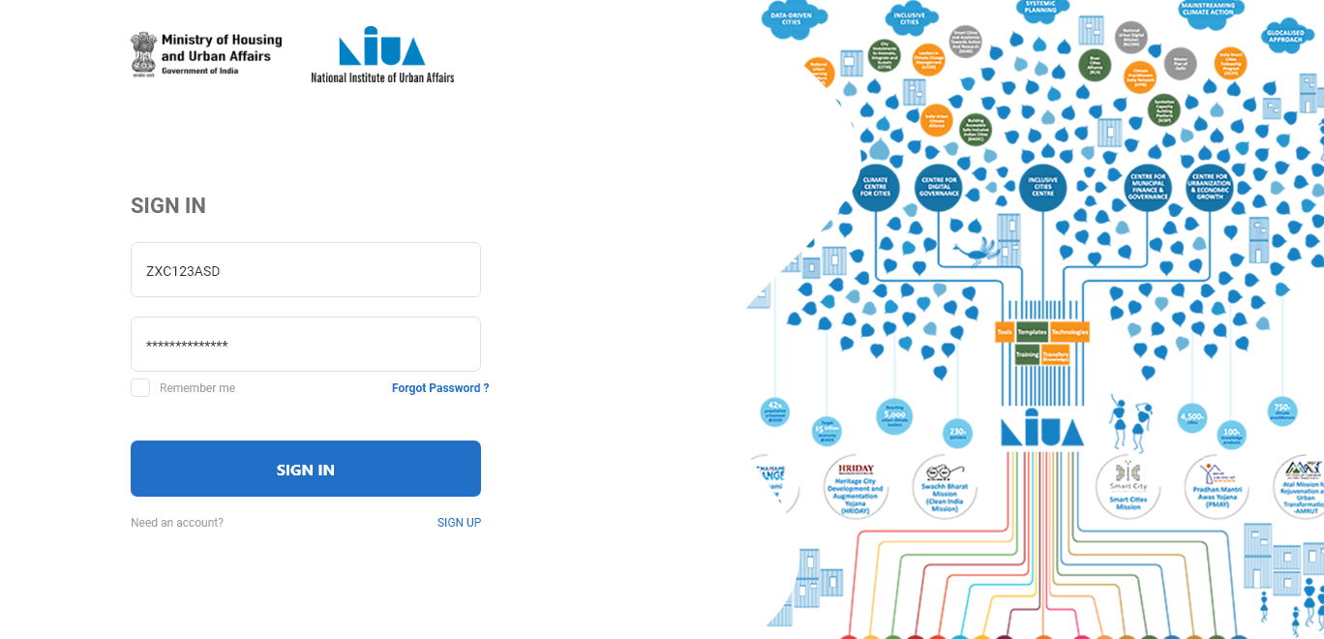
City Official

Slide 4
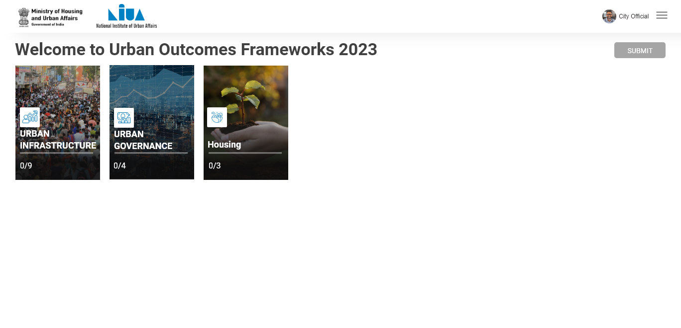
City Official

Slide 5
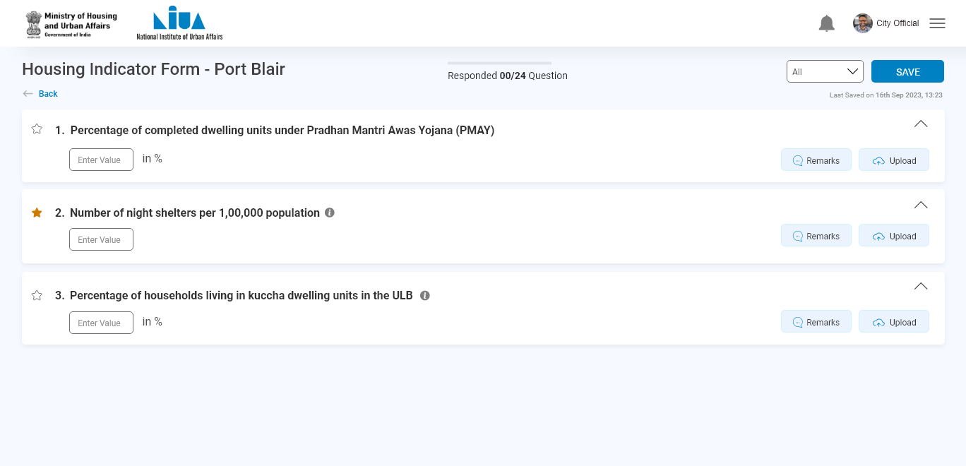
City Official
Click here !

Slide 6
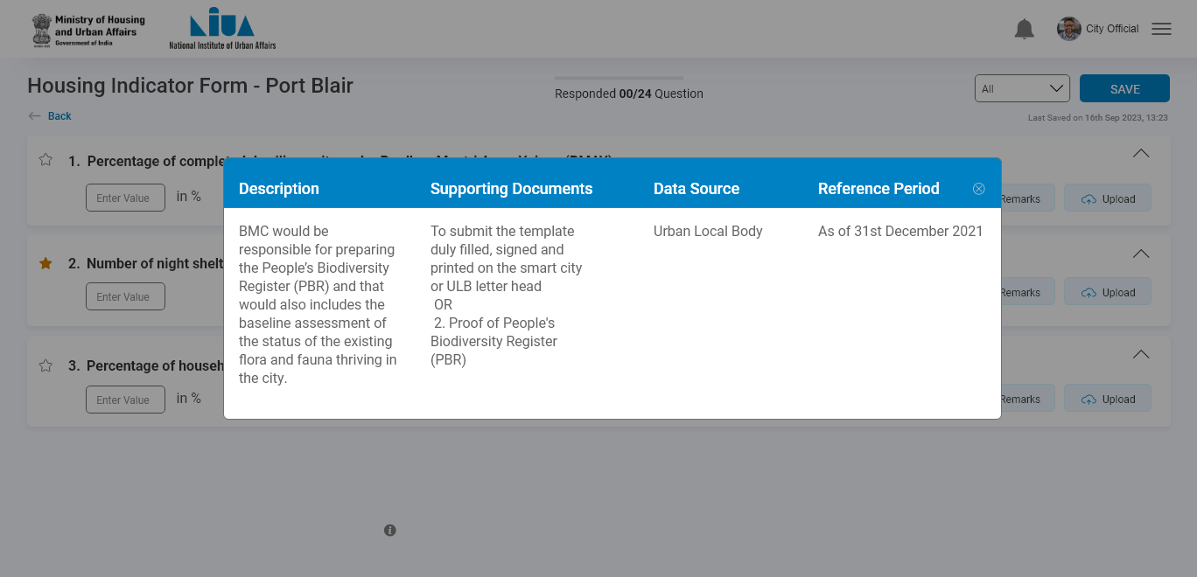
City Official

Slide 7
City Official
Click here !

Slide 8
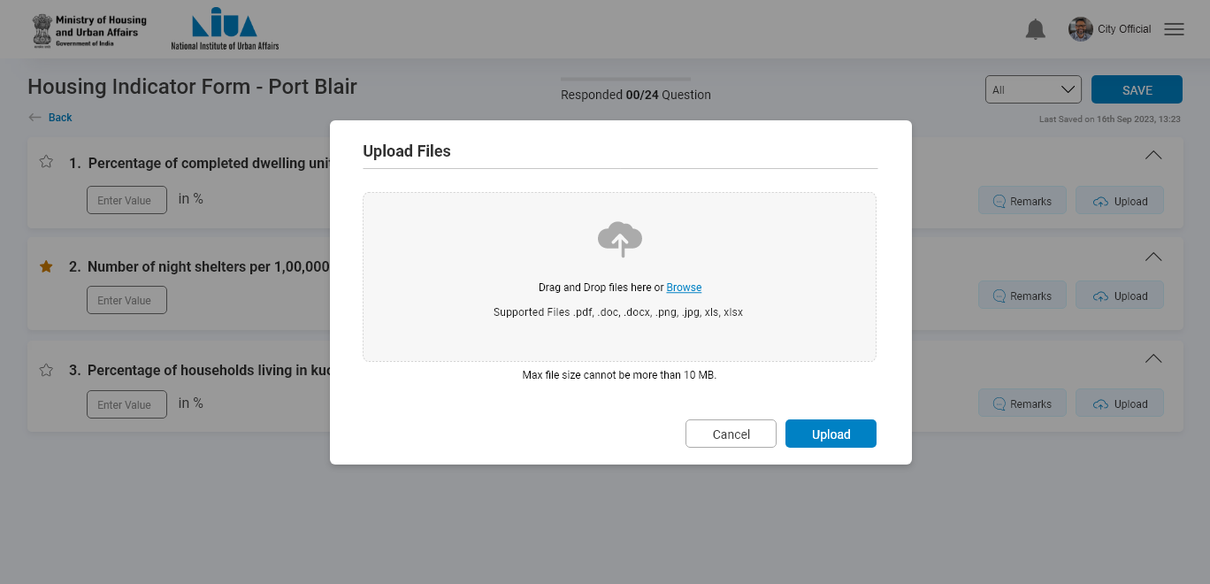
City Official

Slide 9

City Official
Click here !

Slide 10
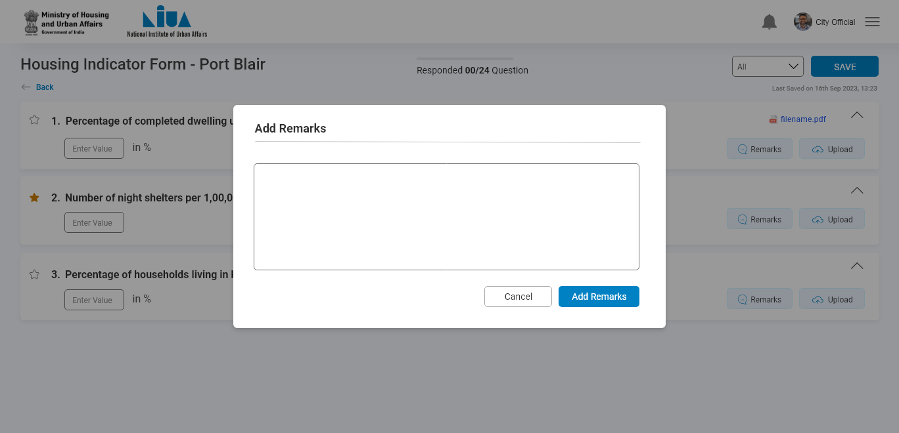
City Official

Slide 11
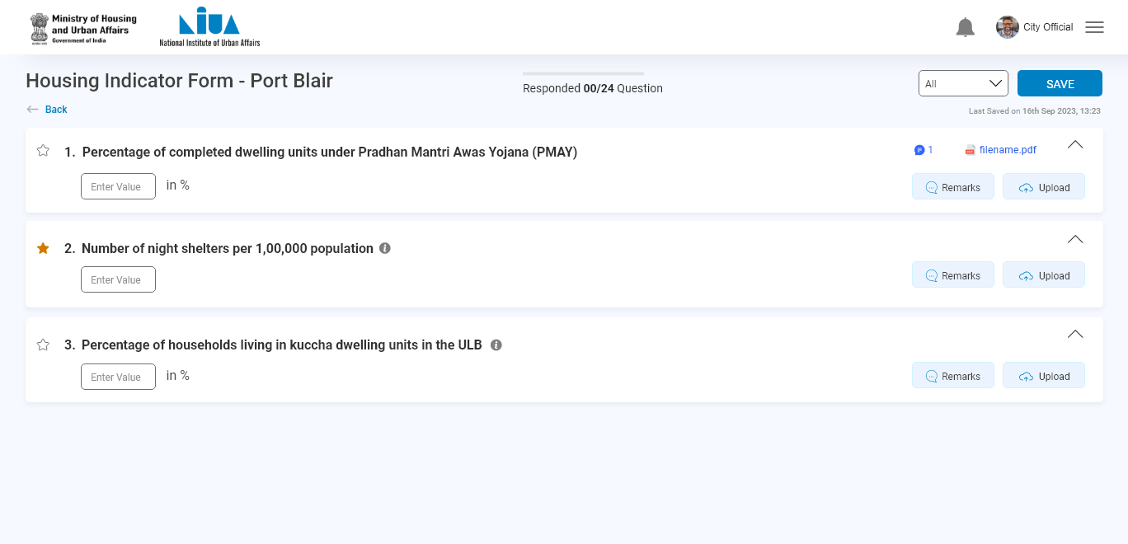
City Official

Slide 12
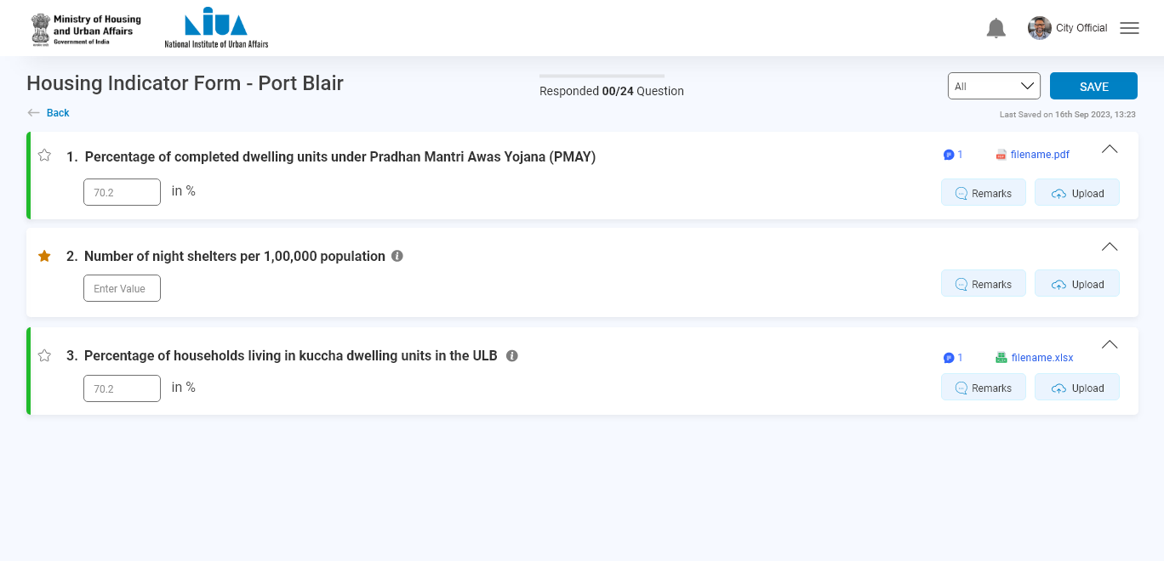
City Official
Similar actions can be done for this question

Slide 13
City Official
Click on save

Slide 14
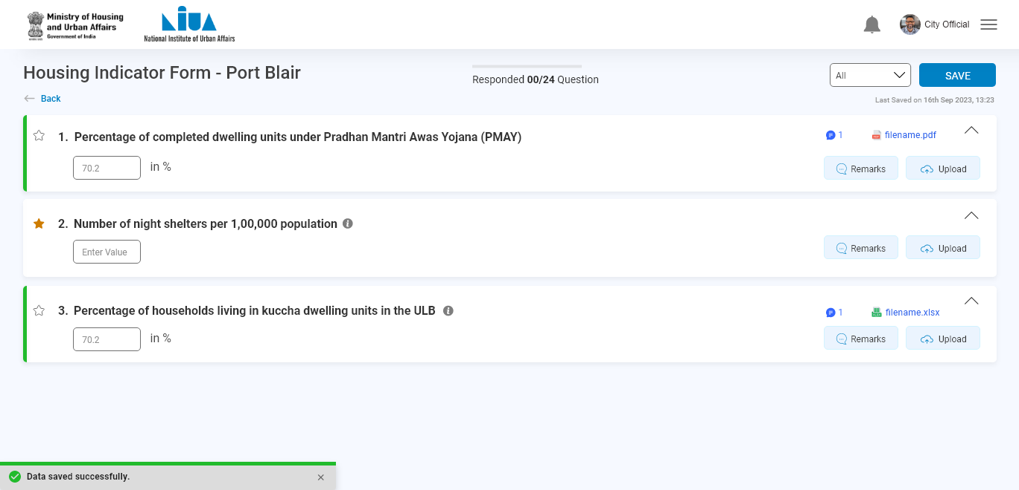
City Official

Slide 15

City Official
You can see the status here

Slide 16
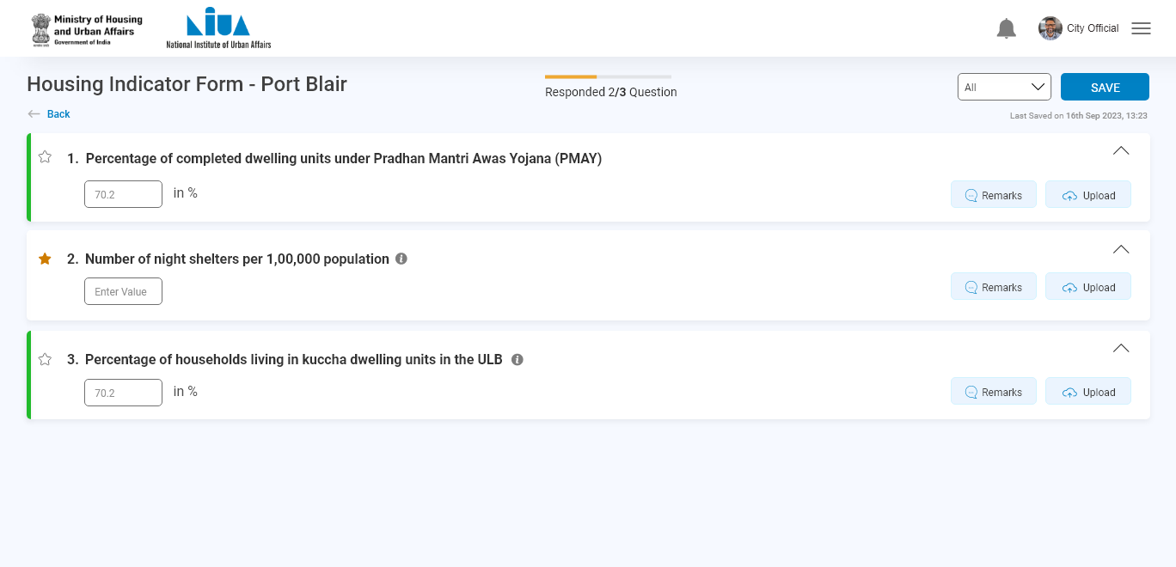
City Official
Select the category of bookmark question from here
Bookmark question

Slide 17
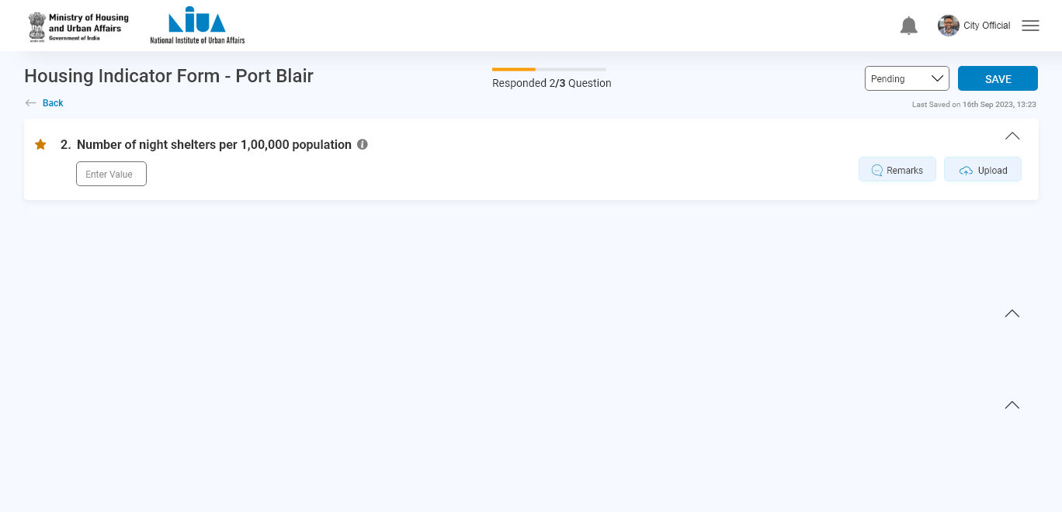
City Official

Slide 18
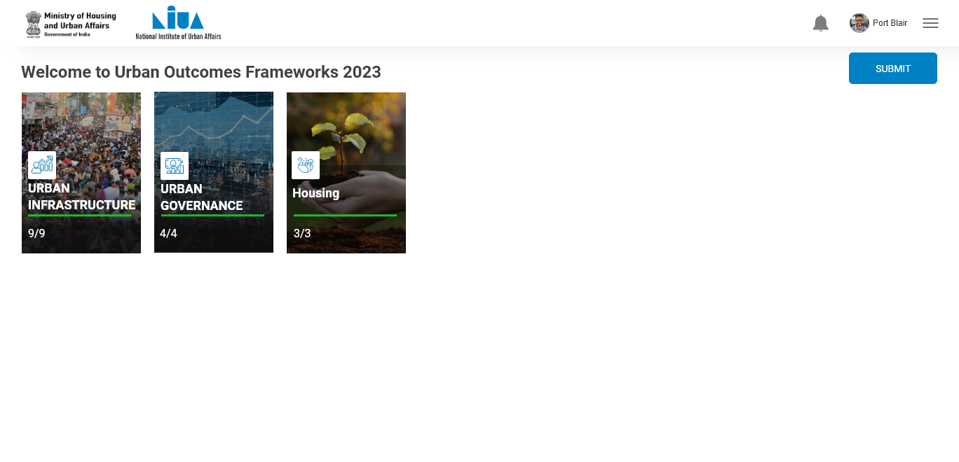
City Official
Click on submit
After submitting all the sectors , submit button activated

Slide 19
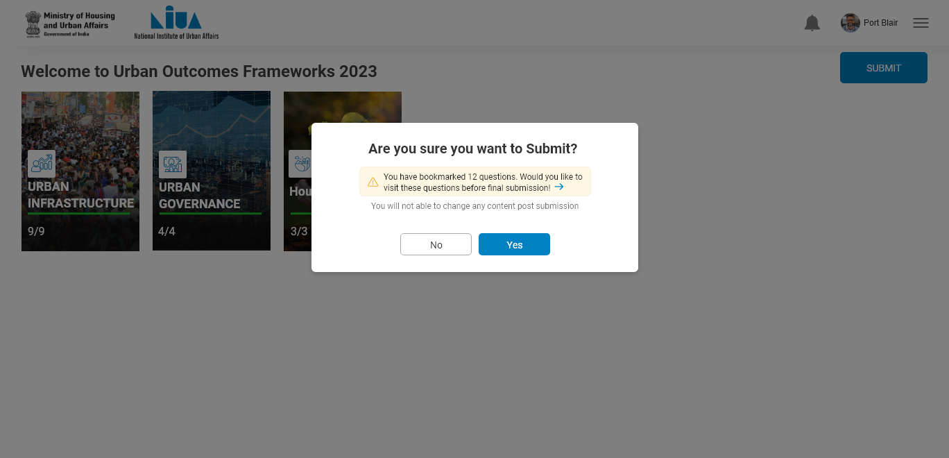
City Official

Slide 20
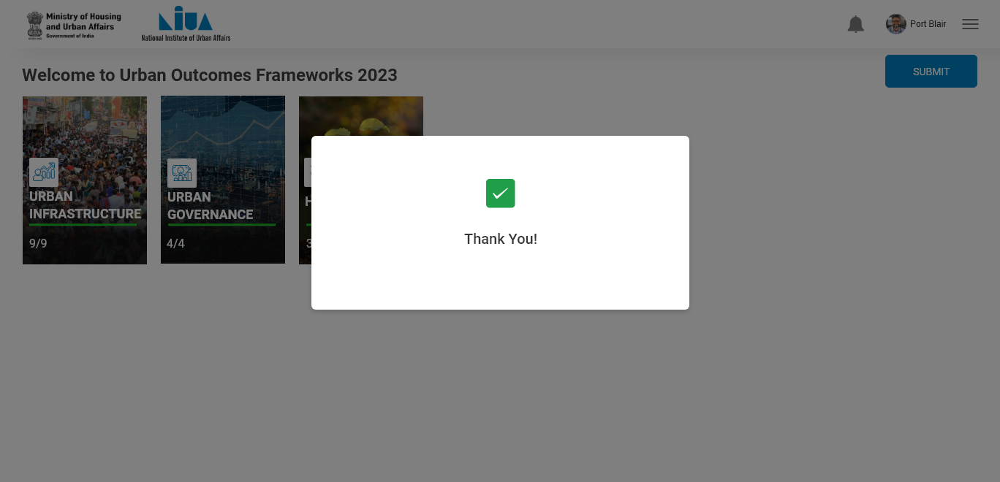
City Official

Slide 21

City Official
After submitting, through this button, nothing will be editable to city user

Slide 22
Validator 1

Slide 23

Validator 1

Slide 24
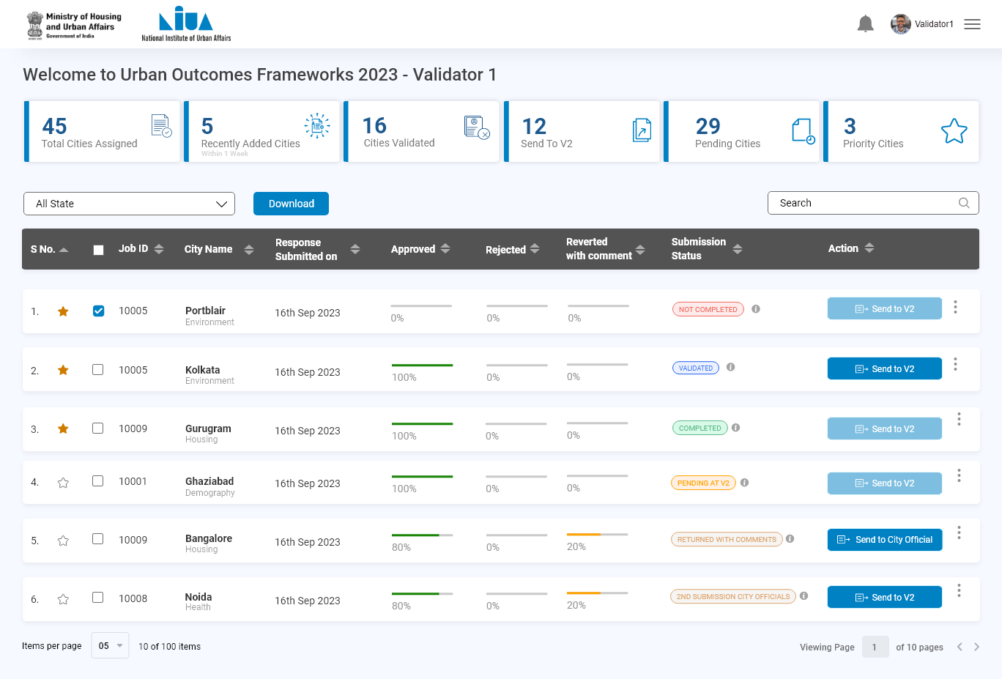
Validator 1

Slide 25
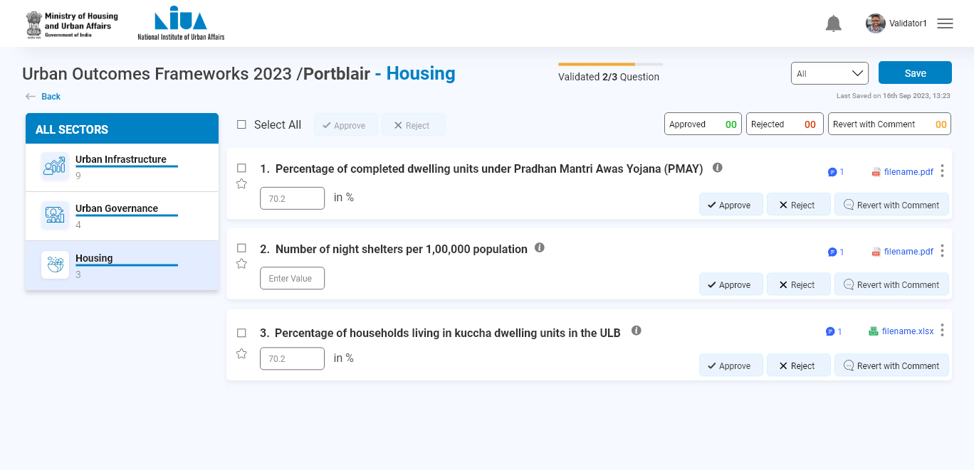
Validator 1

Slide 26
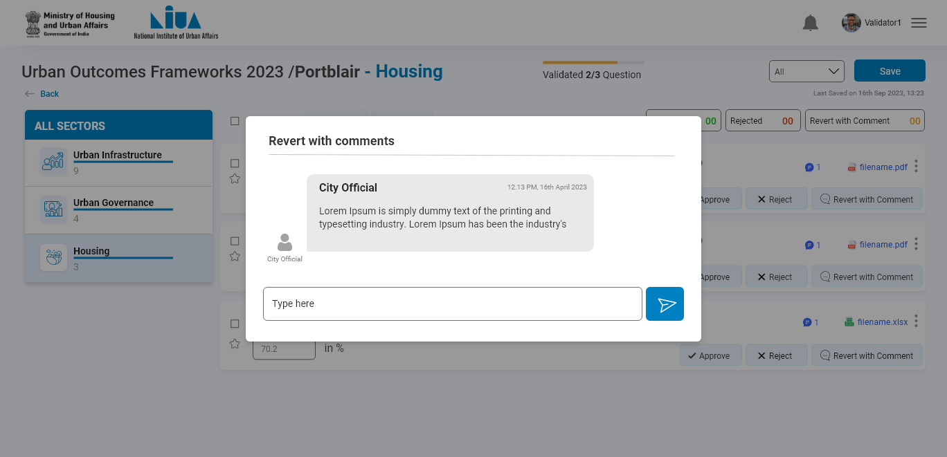
Validator 1

Slide 27

Validator 1

Slide 28
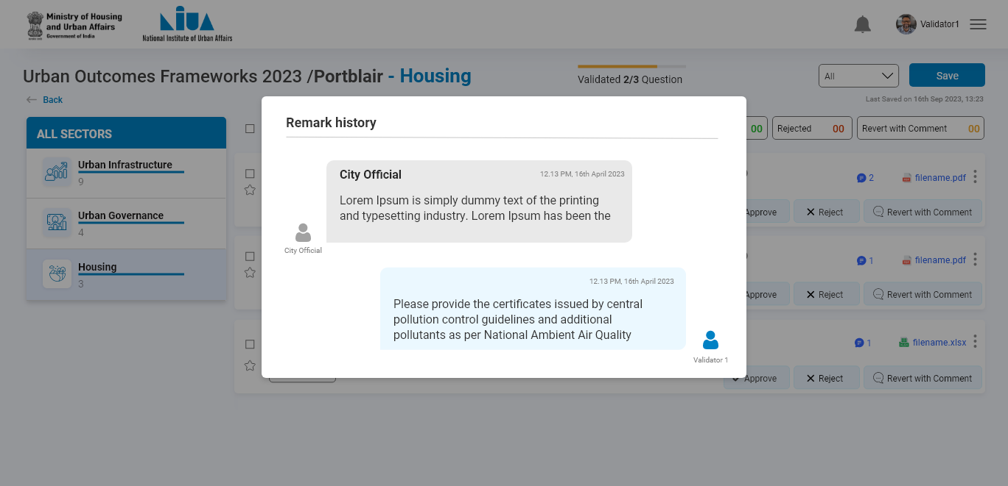
Validator 1

Slide 29
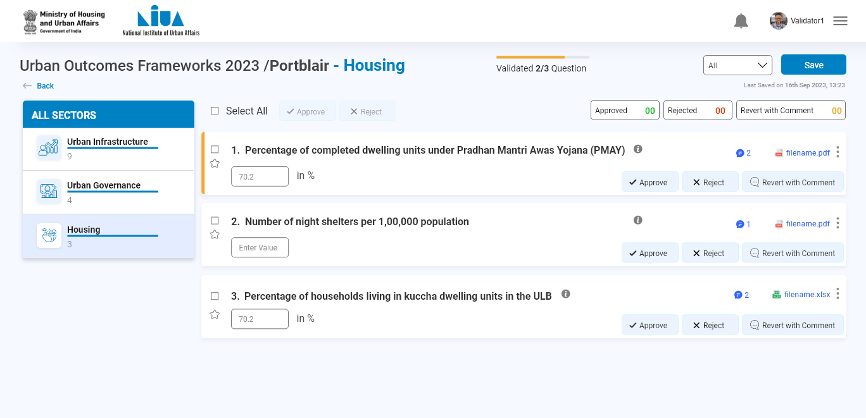
Validator 1

Slide 30
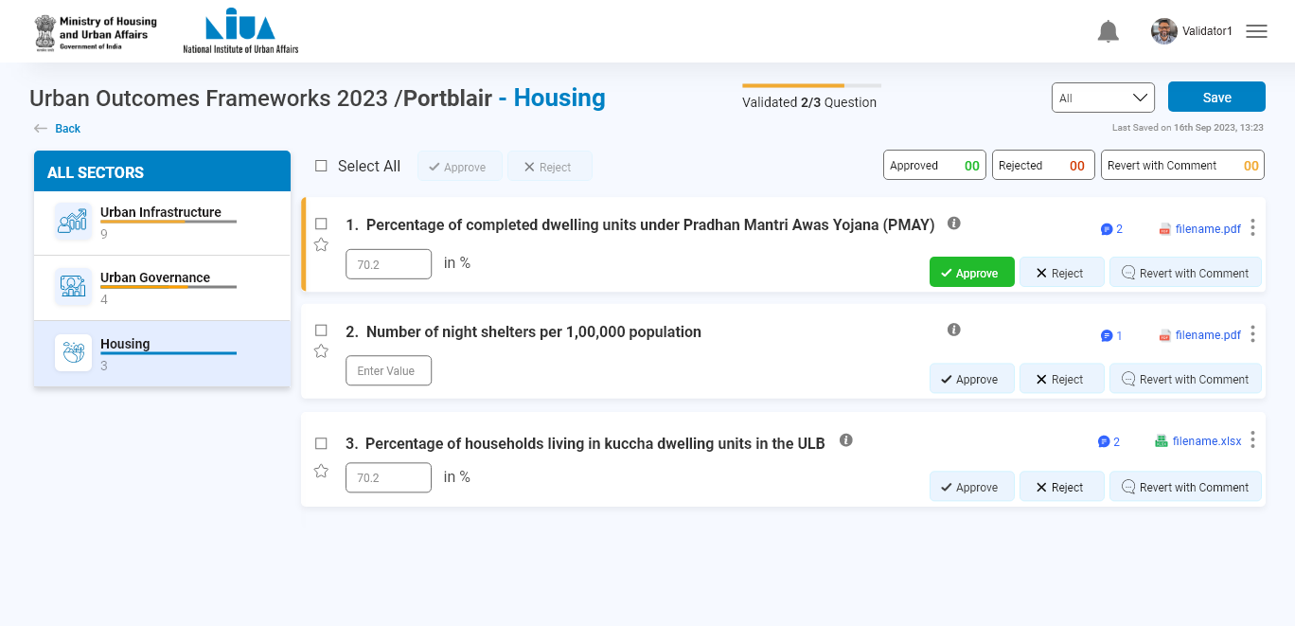
Validator 1

Slide 31
Validator 2

Slide 32

Validator 2

Slide 33
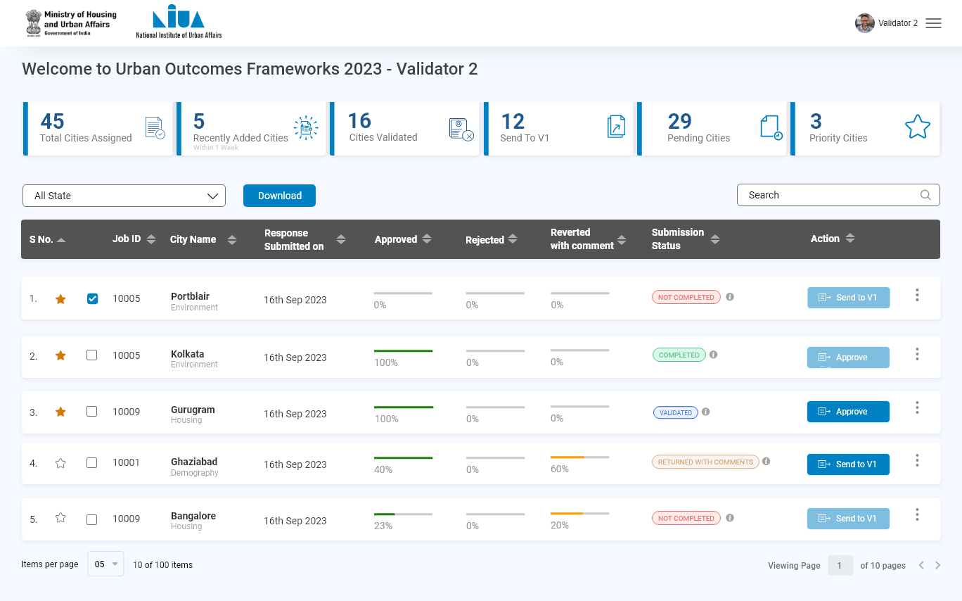
Validator 2

Slide 34
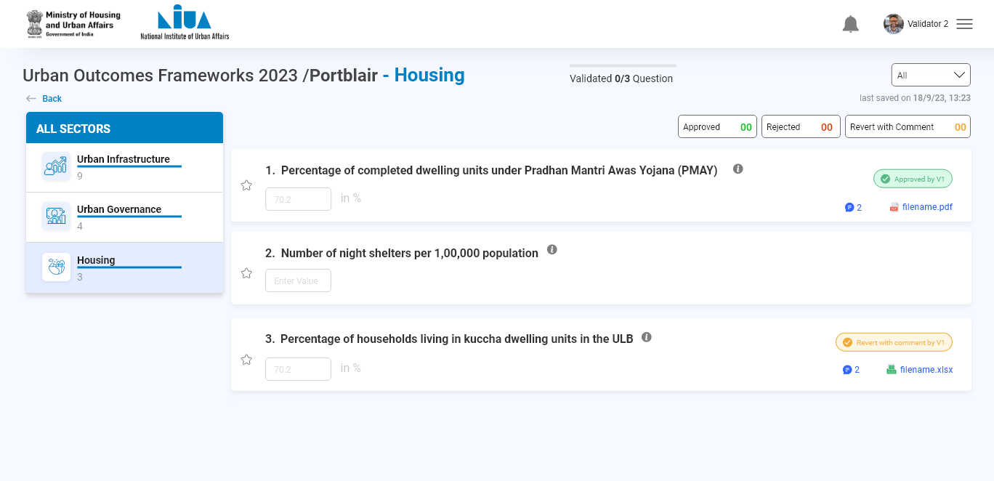
Validator 2

Slide 35
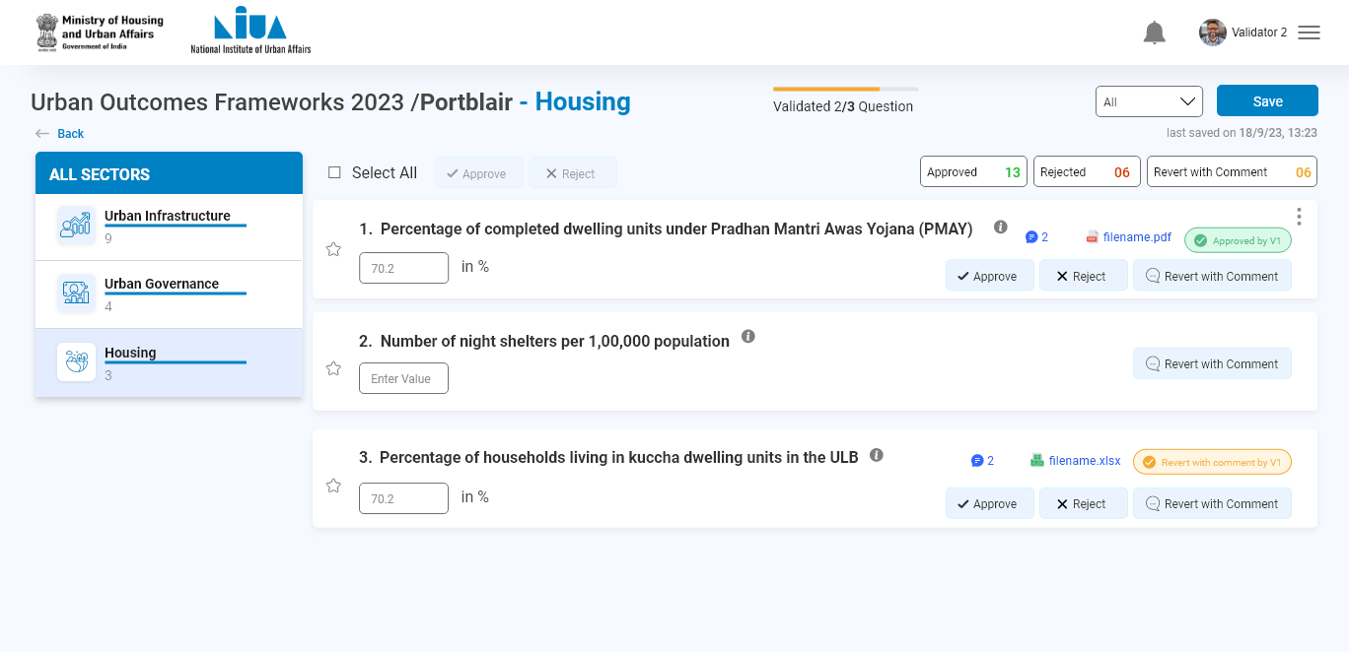
Validator 2

Slide 36
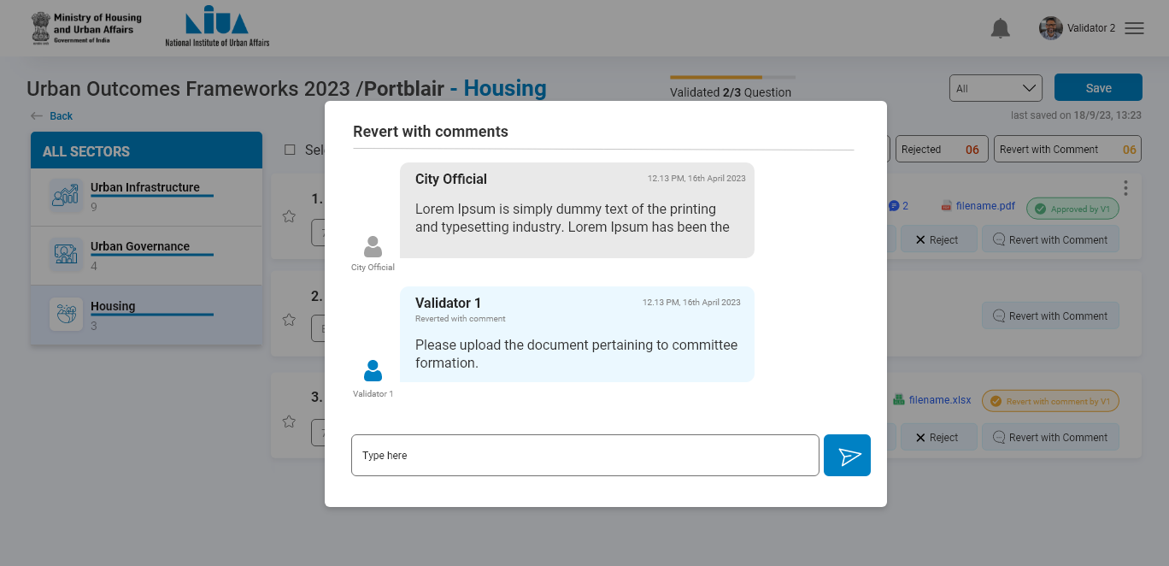
Validator 2

Slide 37

Validator 2

Slide 38
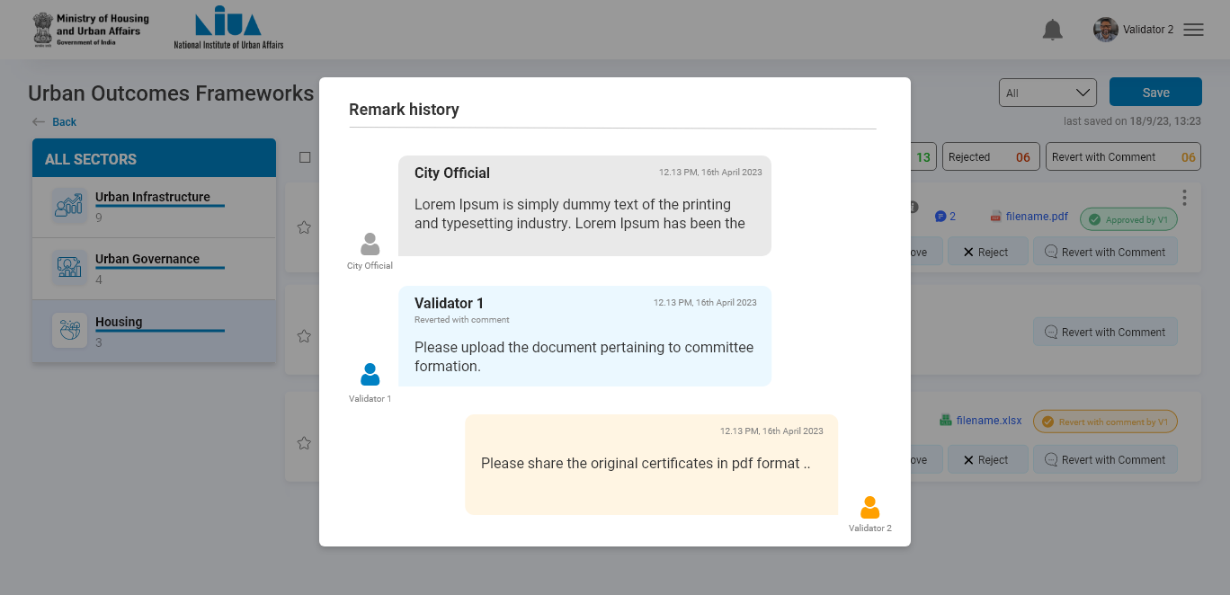
Validator 2

Slide 39

Validator 2

Slide 40
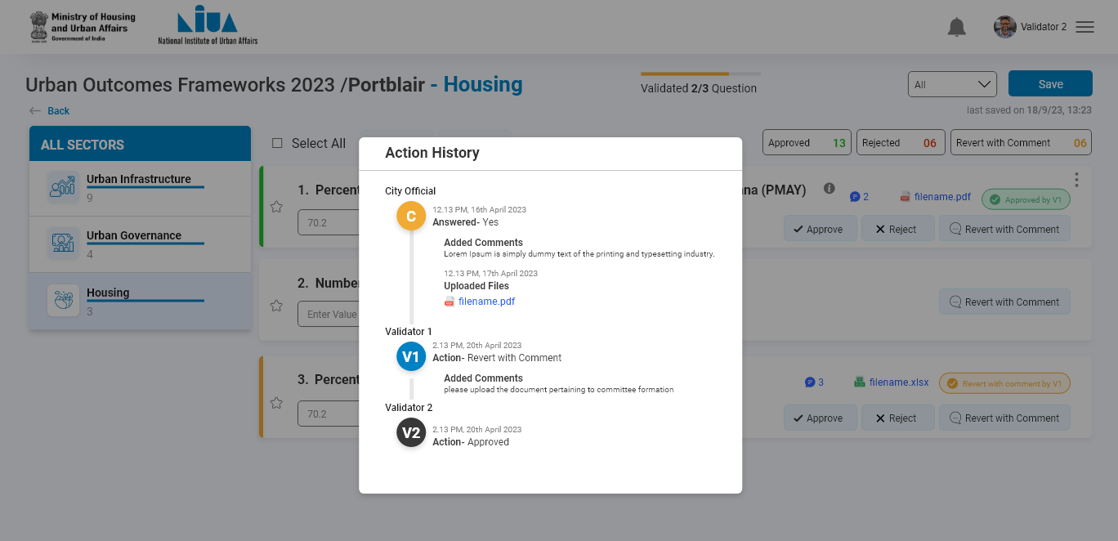
Validator 2

Slide 41
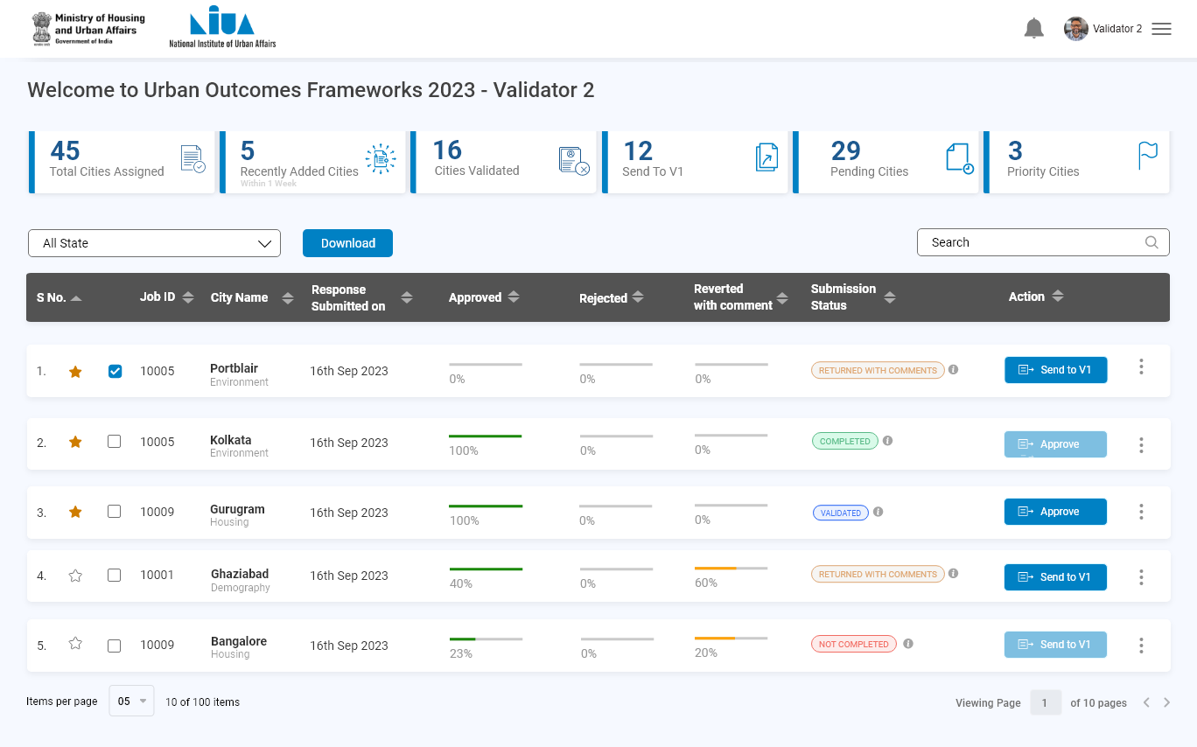
Validator 2

Slide 42
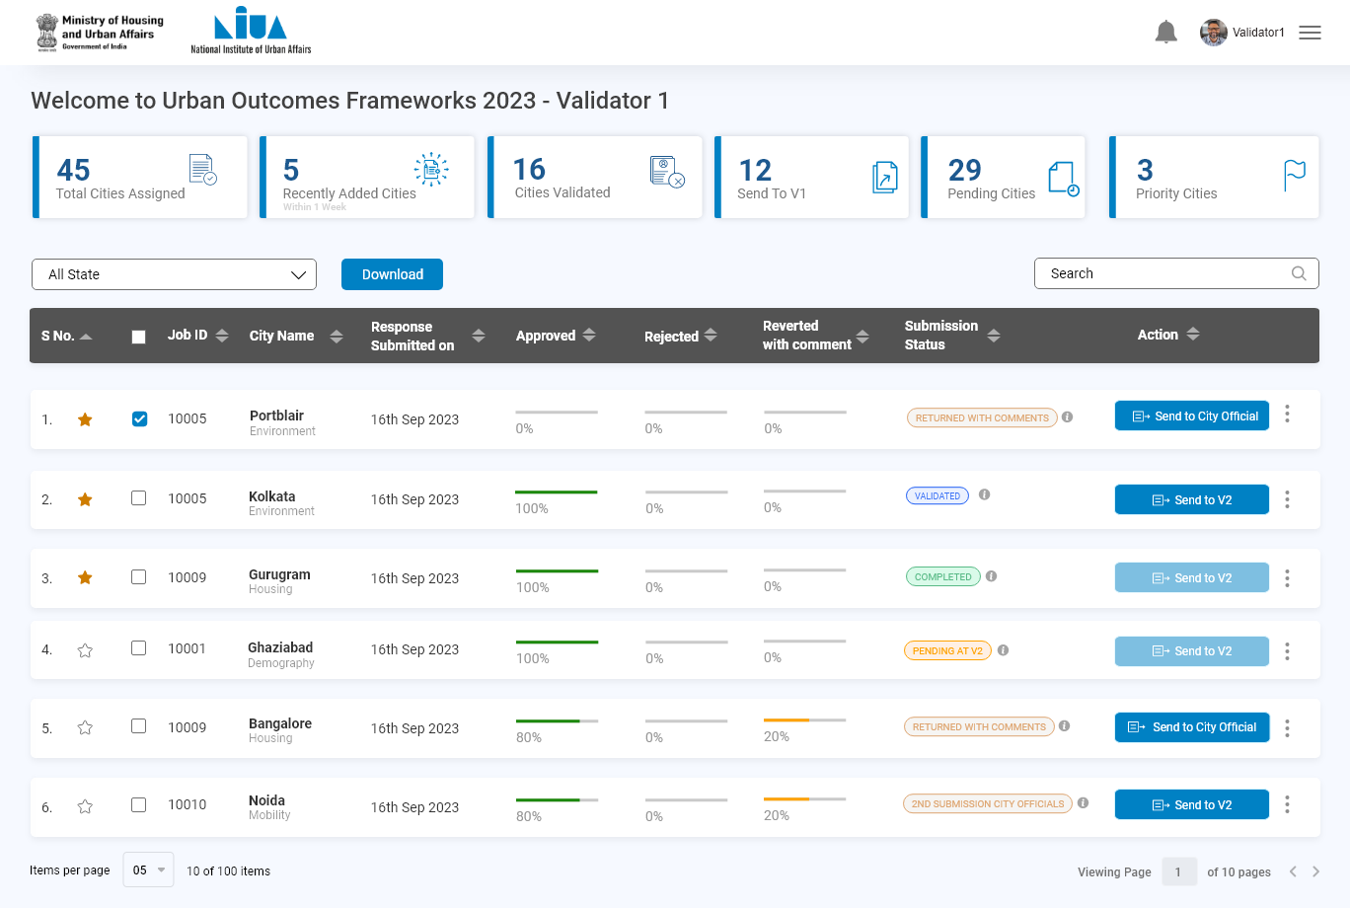
Validator 2

Slide 43
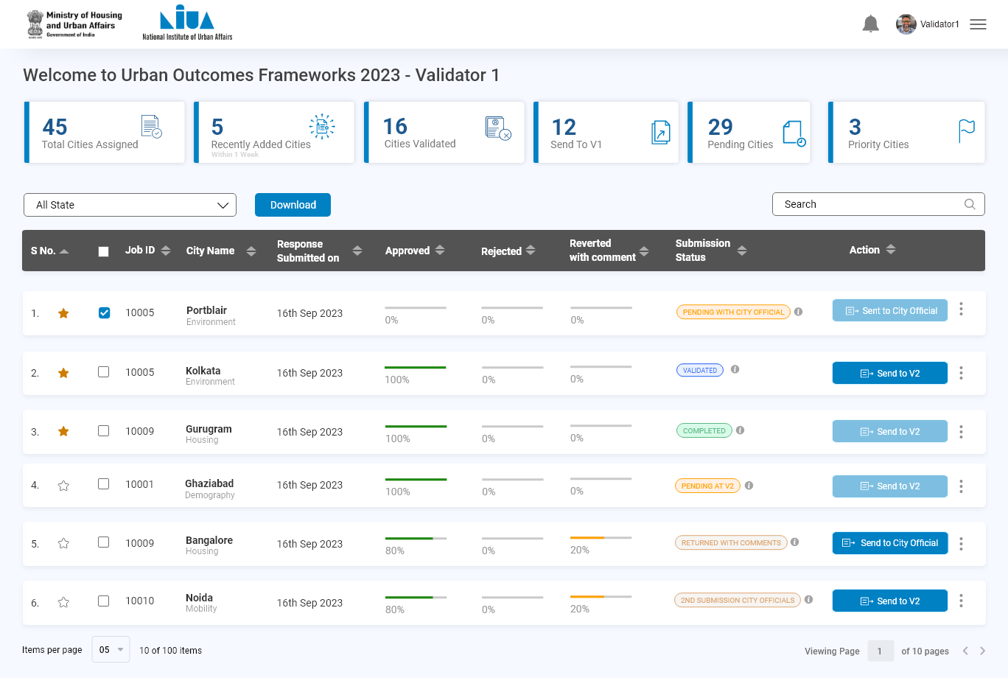
Validator 2

Slide 44
City Official
Relogin to view the comments

Slide 45

City Official

Slide 46
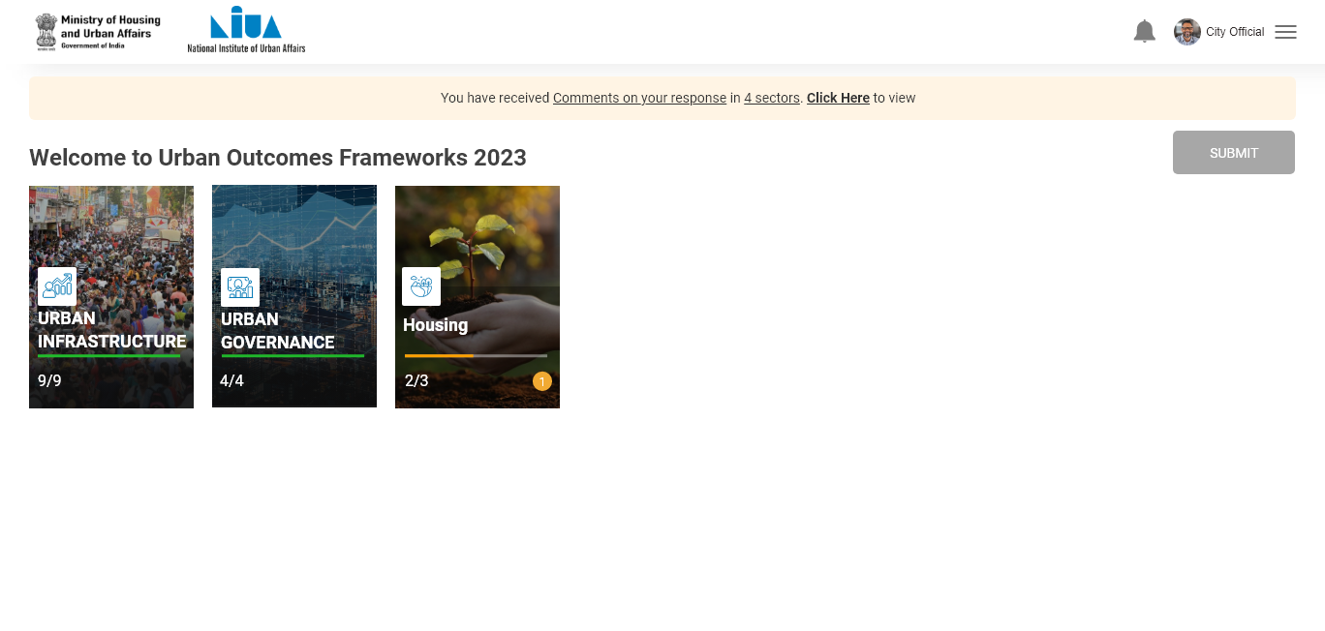
City Official

Slide 47
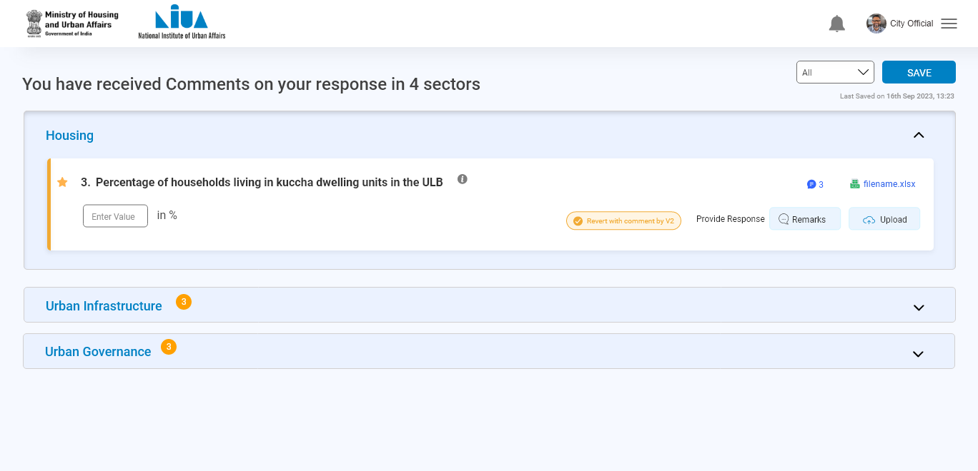
City Official

Slide 48
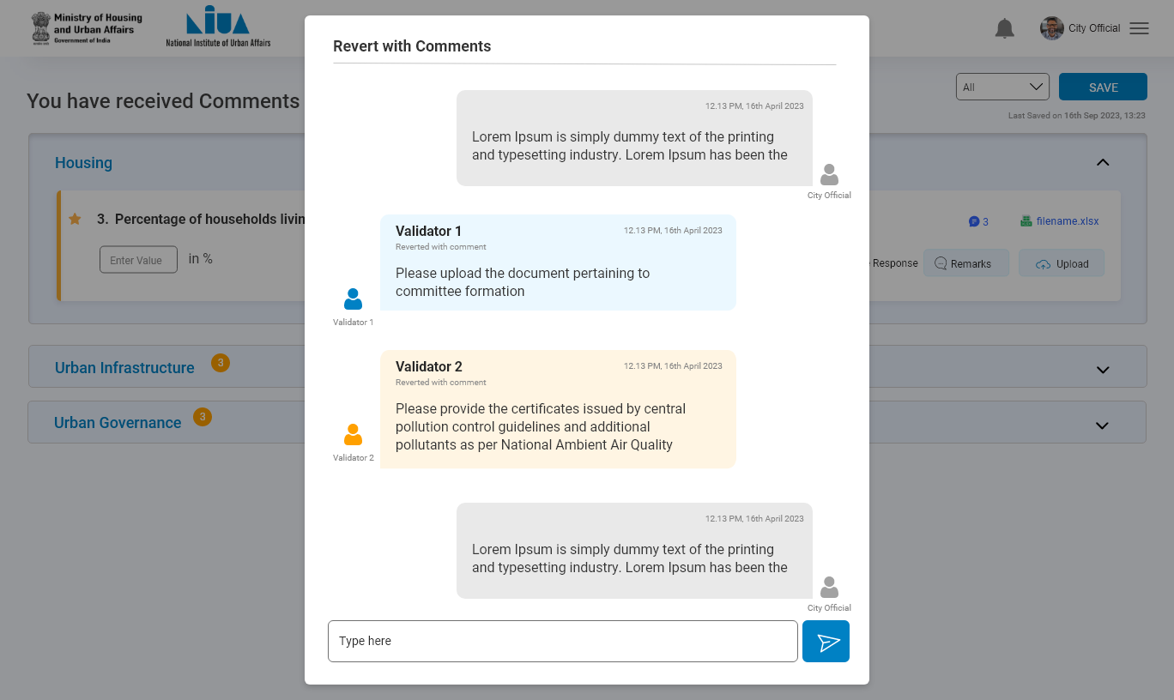
City Official

Slide 49

City Official

Slide 50
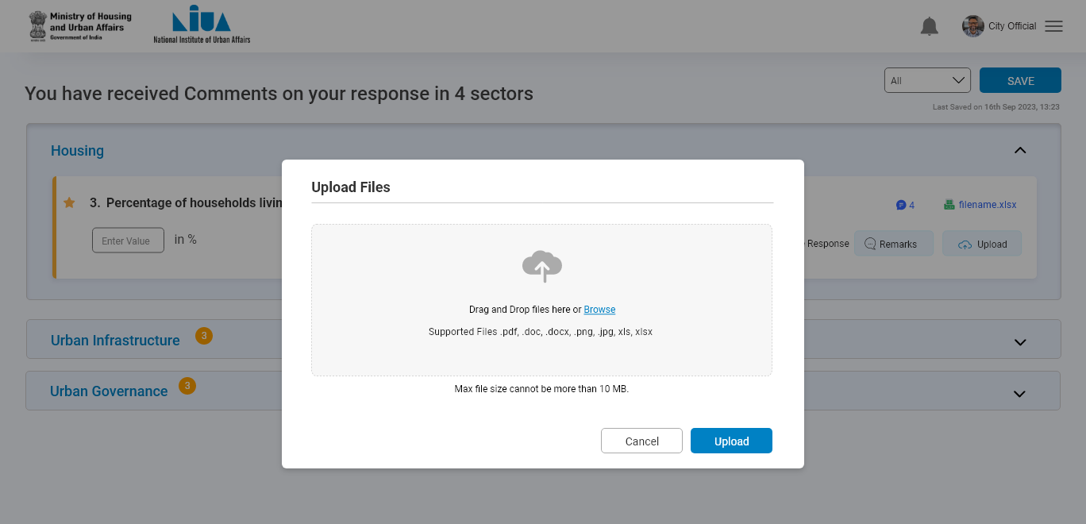
City Official

Slide 51
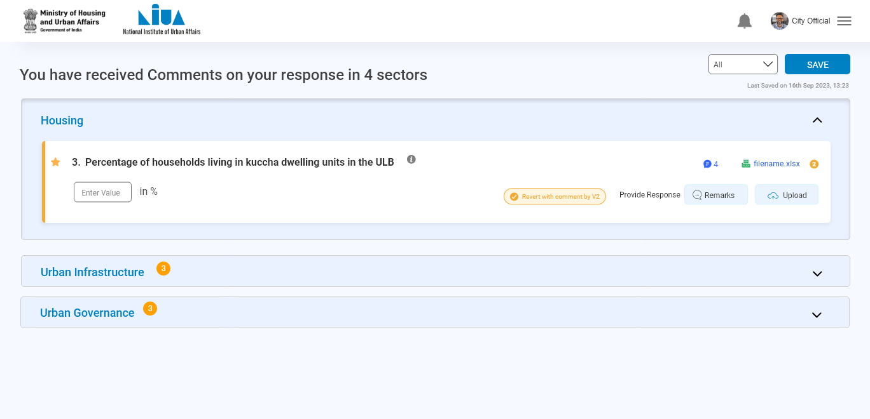
City Official

Slide 52
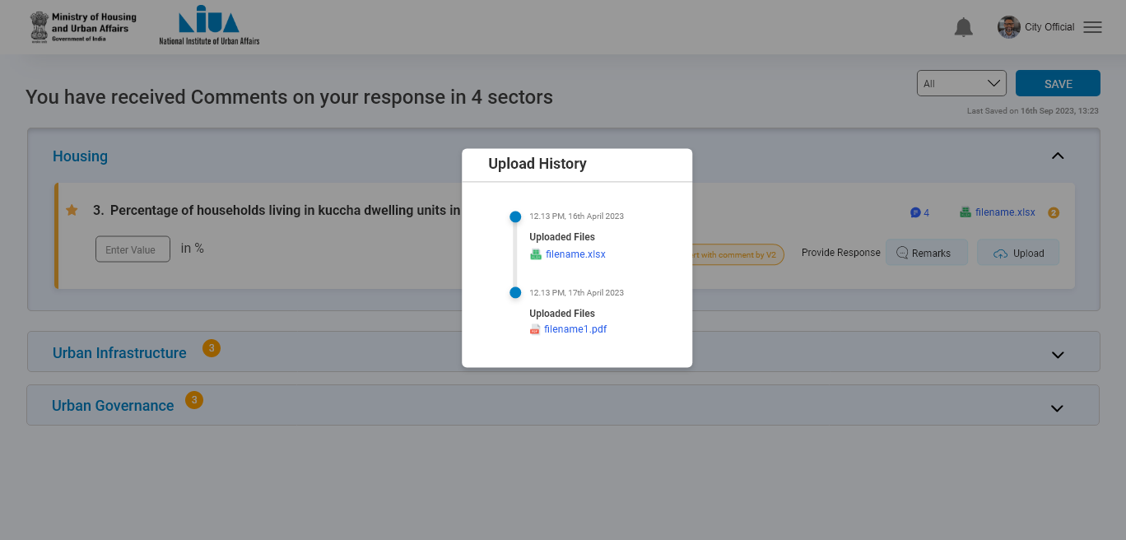
City Official

Slide 53
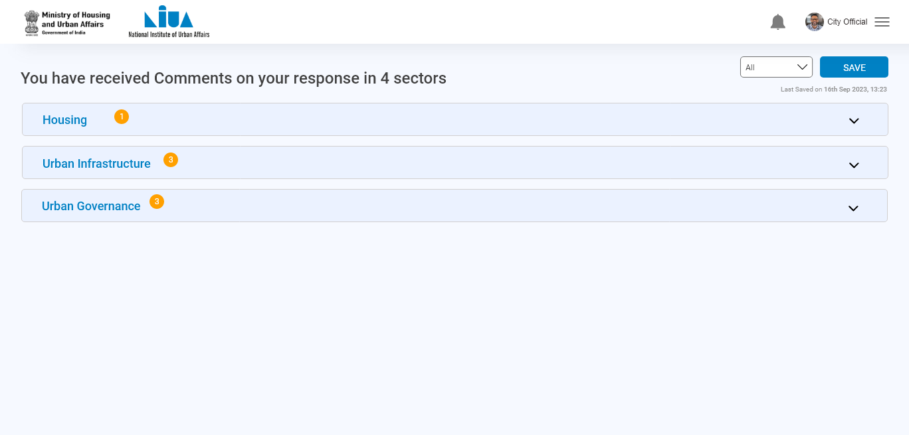
City Official

Slide 54
City Official
Click on submit
After re-submitting all the reverted question , submit button activated

Slide 55
City Official

Slide 56
City Official

